Slide 1
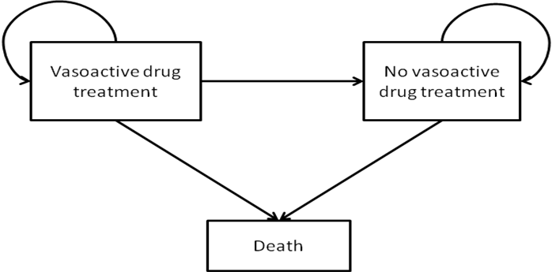
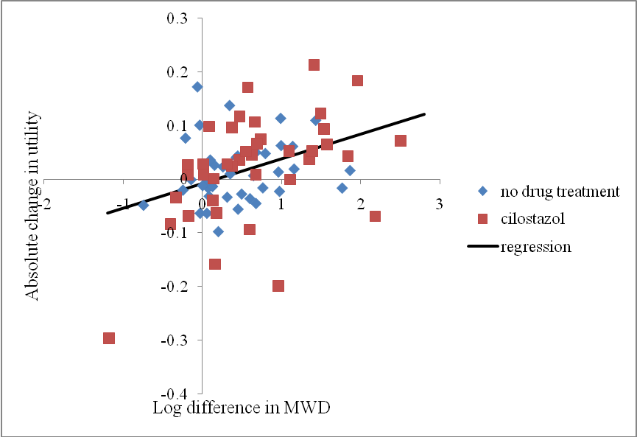
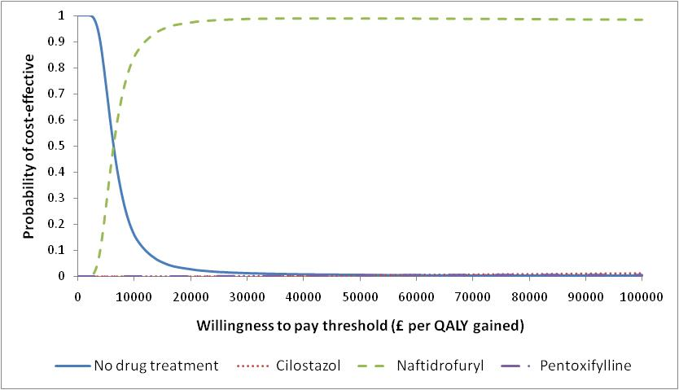
Cost-effectiveness of cilostazol, naftidrofuryl oxalate, pentoxifylline and inositol nicotinate for the treatment of intermittent claudication in people with peripheral arterial disease in the UK
Yang Meng¹, Hazel Squires¹, John Stevens¹, Emma Simpson¹, Sue Harnan¹, Steve Thomas¹, Jonathan Michaels¹, Gerard Stansby², Mark O'Donnell³
School of Health and Related Research, University of Sheffield, United Kingdom
School of Surgical & Reproductive Sciences, University of Newcastle, United Kingdom
Department of Vascular and Endovascular Surgery, Belfast City Hospital, United Kingdom
OBJECTIVES
The study aims to assess the cost-effectiveness of the vasoactive drugs cilostazol, naftidrofuryl oxalate, pentoxifylline and inositol nicotinate for intermittent claudication due to peripheral arterial disease (PAD) in adults whose symptoms continue despite a period of conservative management.
CONCLUSIONS
This is the first published cost-utility analysis in this area which extrapolates data over a lifetime and uses effectiveness evidence from a network meta-analysis.
In contrast to previous guidelines recommending cilostazol, this comprehensive analysis suggests that naftidrofuryl oxalate is the only vasoactive drug for PAD which is likely to be cost-effective at a willingness to pay threshold of £20,000 per QALY gained.
Methods
A Markov decision model was developed to assess the lifetime costs and benefits of each vasoactive drug compared with no vasoactive drug and with each other (see Figure 1).
Maximum walking distance (MWD) effectiveness estimates were based on a network meta-analysis of MWD following a systematic review of the literature.
Regression analysis was undertaken to model the relationship between MWD and utility based on patient-level data from a trial of cilostazol to enable quality of life impacts to be estimated for the other drugs under consideration (see Figure 2).
Resource use data were sourced from the literature.
A comprehensive sensitivity analysis, including probability sensitivity analysis, was undertaken.
RESULTS
Naftidrofuryl oxalate is more effective and less costly than cilostazol and pentoxifylline and has an estimated cost per quality-adjusted life year (QALY) gained of around £6,070 compared with no vasoactive drug (see Table 1).
The probability of cilostazol or pentoxifylline being the most cost-effective at any willingness to pay threshold is less than 1%. Naftidrofuryl oxalate has the highest probability of being the most economically attractive option above willingness to pay thresholds of around £6,000 per QALY gained (see Figure 3).
Whilst there is limited effectiveness evidence associated with inositol nicotinate, threshold analysis suggests that it is unlikely to be considered to be cost-effective due to its more expensive acquisition cost.
Figure 1. Model structure
Table 1. Incremental discounted cost-effectiveness results (base case)
Interventions and comparator | Total costs (additional to no vasoactive drug treatment) (£) | Total QALYs | Incremental cost-effectiveness ratio (£ per QALY gained) | Dominance
No vasoactive drug (baseline technology) | £0 | 4.975 | -
Pentoxifylline | £493 | 4.984 |  | Dominated by naftidrofuryl oxalate
Cilostazol | £964 | 4.994 |  | Dominated by naftidrofuryl oxalate
Naftidrofuryl oxalate | £298 | 5.024 | £6,070
Figure 2. Relationship between MWD and utilities
Figure 3. Cost-effectiveness plane showing incremental effectiveness and costs of the vasoactive drugs versus no vasoactive drug (base case)
REFERENCES
Full report available at http://www.hta.ac.uk/project/2246.asp
This work was funded by the UK National co-ordinating Centre for Health Technology Assessment (NCCHTA). The views and opinions expressed are those of the authors and do not necessarily reflect those of the UK Department of Health. Project Number 09/92/01
CONTACT: Yang Meng, Research Fellow, Health Economics and Decision Science, School of Health and Related Research, University of Sheffield, U.K. Email: y.meng@sheffield.ac.uk Tel: +44 (0)1142220673

