Slide 1
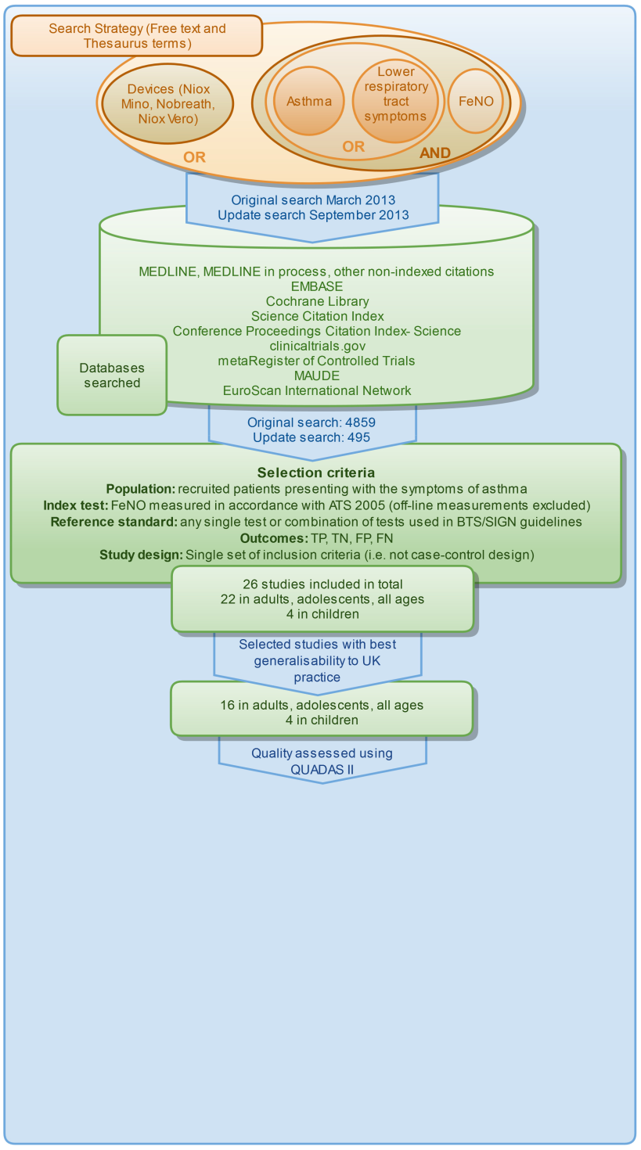
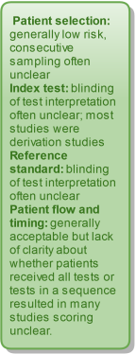
EXHALED NITRIC OXIDE FOR THE DIAGNOSIS OF ASTHMA IN ADULTS AND CHILDREN: A SYSTEMATIC REVIEW
School Of
Health
And
Related
Research
Harnan, S¹, Essat M¹, Gomersall T¹, Tappenden P¹, Wong R¹, Lawson R², Pavord I³, Everard M⁴.
1 Health Economics and Decision Science, University of Sheffield; 2 Department of Respiratory Medicine, Royal Hallamshire Hospital; 3 Nuffield Department of Medicine, University of Oxford; 4 School of Paediatrics and Child Health, University of Western Australia, Princess Margaret Hospital
November 2015.
Heterogeneity precluded meta-analysis. Studies synthesised narratively, sub-groped according to patient selection criteria and reference standard used.
Patients with symptoms of asthma versus a pathway of tests including airway reversibility and AHR
Cut-off for highest sum of sensitivity and specificity ranged 20 ppb to 47 ppb. Estimates of sensitivity ranged 32% to 88%. Estimates of specificity ranged 60% to 93%. Cut-offs ranging 9 ppb to 25 ppb had sensitivity ranging 69% to 100%. Cut-offs ranging 76-100ppb had specificity ranging 97% to 100%.
Patients with symptoms of asthma versus airway reversibility
NOTE: Data presented for cut-off 40 ppb, data for cut-off with highest sum of sensitivity and specificity (41.7 ppb) not reported. Cut-off 25 ppb had sensitivity 83.3%. Cut-off of 110 had specificity 95%
Difficult to diagnose patients versus AHR
Methods
Cut-off for highest sum of sensitivity and specificity varied from 30 ppb to 40 ppb. Estimates of sensitivity ranged 100% to 35%. Estimates of specificity ranged 95% to 29.2%.
Results
Patients with chronic cough, who tested negative for other causes (e.g. chest radiograph), versus ICS responsiveness
Cut-off for highest sum of sensitivity and specificity varied from 20 ppb to 38 ppb. Estimates of sensitivity ranged from 90% to 53%. Estimates of specificity ranged from 85% to 63%.
Children with asthma symptoms versus pathway of tests including airway reversibility and AHR
Cut-off for highest sum of sensitivity and specificity varied from 19 ppb to 21 ppb. Estimates of sensitivity ranged from 49% to 89%. Estimates of specificity ranged from 76% to 89%.
Other studies
Results
This project was funded by the National Institute of Health Research (NIHR) Health Technology Assessment (HTA) Programme (project number 12/60/01). The views expressed therein are those of the authors and do not necessarily reflect those of the HTA Programme, NIHR, NHS or the Department of Health.
s.harnan@sheffield.ac.uk
www.facebook.com/scharrsheffield
ruth.wong@sheffield.ac.uk

