Slide 1
Chronic Illness and Disability in the Workplace
Jared Carnie

Slide 2
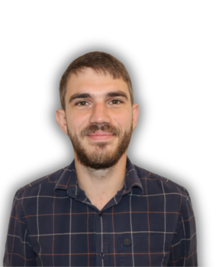
About Me
Operations Manager and Survey Team Lead at NTDC
Worked for last few years in social enterprise offering flexible working opportunities to those living with chronic illness and/or disability
Partner history of chronic illness and health conditions
Notes:
Some caring experience
Able-bodied, second or third-hand experience

Slide 3
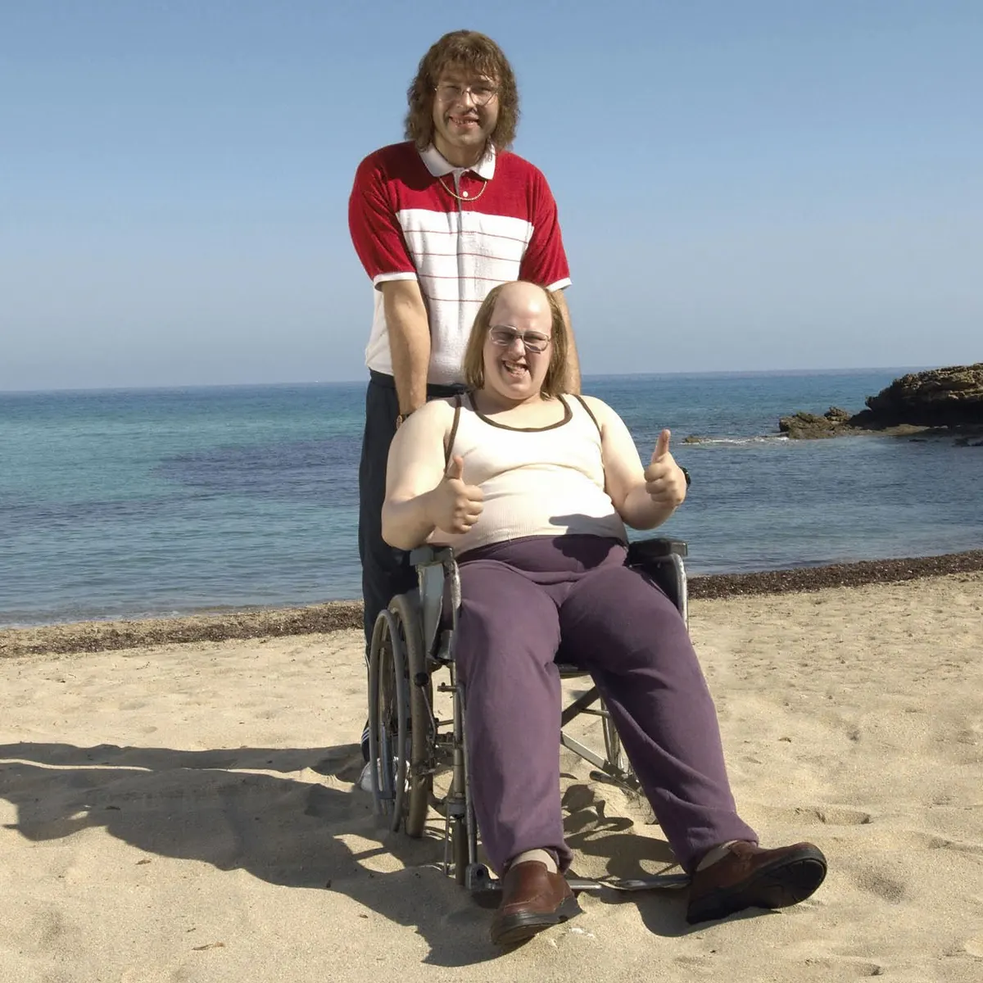
Context and Terminology
Chronic illness can mean long-term illness, energy-limiting chronic illness (ELCI), fluctuating health conditions
Of the 1.2 million wheelchair users in the UK, approximately 1/3rd of those are ambulatory wheelchair users
Notes:
Does that include THIS? The answer is probably yes
Although they use a wheelchair at times, they can still manage to walk a short distance in the right circumstances, often with another mobility aid such as a cane or crutches.

Slide 4
Context
As of Summer 2022, there are approximately 2.5million working-age adults out of work in the UK due to long-term sickness
There are 14.1 million disabled people in the UK - only 52% in employment (Scope)
It costs an additional £581 per month to live with a disability in the UK (Scope)
Notes:
Scope make a number of recommendations re additional financial support that would improve this situation, but here in our workplaces, we can at least look at the working conditions

Slide 5
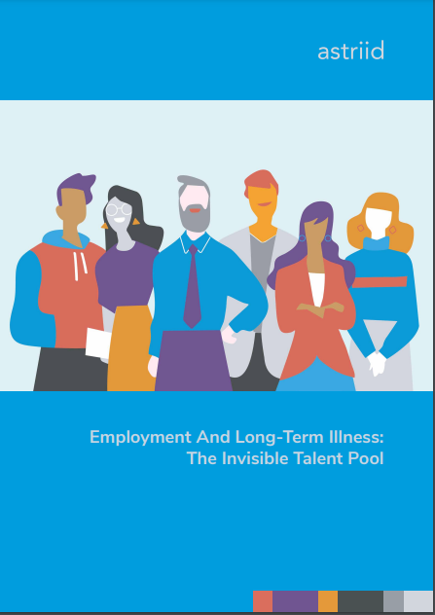
Context - Astriid
Only approximately 6% of vacancies in the UK that offered a salary deemed high enough to live on mentioned flexible working options
Staff with health conditions in work still face major barriers - with the majority feeling that their health is impacting their career prospects and many staff unable to discuss their health condition with their line manager

Slide 6
Context - Evenbreak
Evenbreak surveyed over 3000 disabled people via YouGov
23% said that they felt even mentioning their disability would limit their ability to find employment
Only 23% said they would disclose during a job application, 12% said they would disclose at the interview stage, 22% said they would not disclose at all during hiring process
30% said employers only hire disabled people if they need to fill a quote
Notes:
Even if that isn’t true, it’s still indicative of a problem if people feel that way

Slide 7
Research Culture Survey
at University of Sheffield
Survey created with support from those with lived experience of disability and chronic illness
Survey was shared via University of Sheffield Technical Network, Disability Staff Network and all staff mailing lists
Aimed at technical staff (and staff who ‘support/contribute to research’ also able to take part) with a disability and/or chronic illness (self-defined - staff asked if mental health conditions ‘counted’)
Participants received a gift voucher for their contributions

Slide 8
The Findings:
Workplace Adjustments

Slide 9
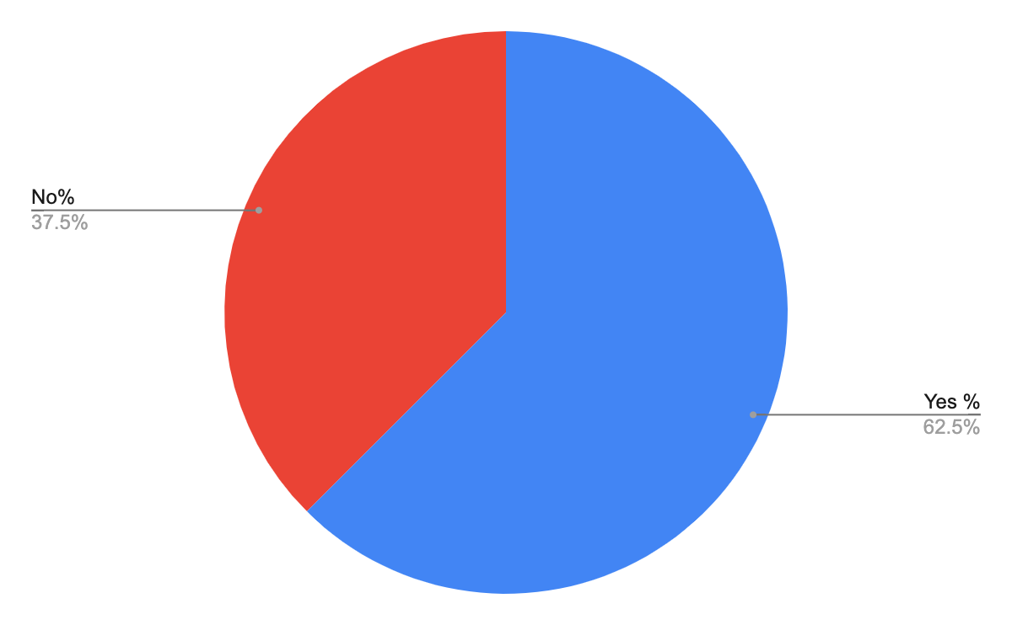
Have you had any adjustments made as part of your role to support working with your disability and/or chronic illness?
Notes:
Explain RED = Bad BLUE = Good - colours will switch from yes to no

Slide 10
Adjustments
“I occasionally work from home”
“Flexible working and temporary disabled parking permit”
“Quiet office (minimal disruptions, reduction in mental stimuli)”
“Informal flexible working”
“Extended phased return (over 3 months) after a year-long sickness absence, temporary working from home, rest breaks included in work day, flexible hours. Also Access to work adjustments have been put in place (ergonomic chair, support sessions, assistive tech and training)”
“Flexible working hours and locations, adjustable desk and chair, software”
“Opportunity to work from home if symptoms worsen, taking regular breaks during longer meetings, breaks between meetings, changing my day off to the middle of the week”
“Flexible start/end time, extra info written down when needed, offered help and signposted to other uni help”
“Office on same floor as lab, raised desk, orthopaedic chair, foot stool. Lab relocated to closer to the toilet. Raised equipment in lab, footstools in lab, flexible working. Disabled parking”
Notes:
Not just about static health conditions, these things can fluctuate, or can take gradual, long recovery times

Slide 11
Impact of Adjustments
“Very, they made a huge difference”
“Very beneficial, as my illness is unpredictable and it took the pressure off to be present in the office every day”
“Very - flexible hours (within reason) alleviates a huge amount of stress”
“Very beneficial”
“They have enabled me to stay in work and not have to take time off sick, as I have been better able to manage my symptoms”
“Very beneficial and less physically demanding”
“For back problems, OH recommendation for height adjustable table, anti fatigue mats & physio - both adjustments proved beneficial”
“Couldn’t do job without them”
“Made me feel much more comfortable during a flare up of my condition”
“They were essential to me being able to remain in work. I would have had to leave if these were not put in place. I was also able to make some recovery whilst being back at work because of the adjustments”
“The parking permit helped me get back to work sooner as it saved 2 hours travel time on public transport per day.
Flexible hours are helpful on my bad days”
Notes:
Shows the impact of adjustments

Slide 12
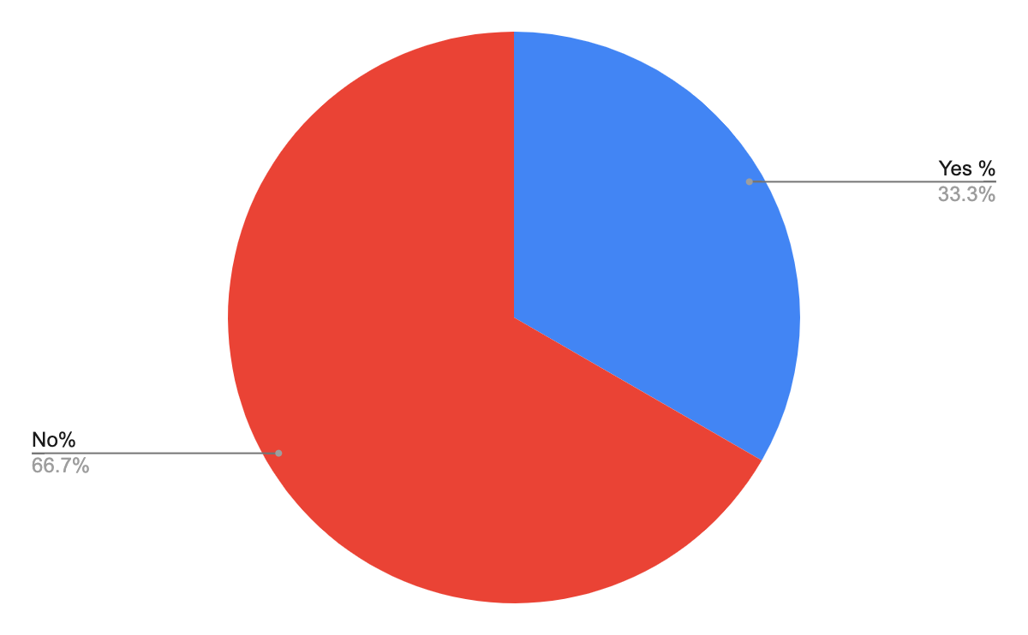
Are there any specific adjustments that haven't been made that you feel would benefit your ability to carry out your role and manage your health?
12.5% said they have NOT had any opportunity to voice any potential adjustments that would benefit their ability to carry out their role

Slide 13
Which specific adjustments that haven't been made do you feel would benefit your ability to carry out your role and
manage your health?
“I would ask for flexibility and understanding from managers when I can't get to work”
“Hybrid as default, a culture of no immediate back-to-back meetings (rather than having to be requested individually)”
“When I first started working here I had a phone call with work health team or something and they suggested some softwares to help with my dyslexia, these were never actually put in place and I did not know who to reach out to regarding this, so I don’t know if these would have been helpful but I have never had access to them”
“Condensed hours, working my hours in 4 longer days not 5”
“My manager thought my requests were outrageous. I was not permitted to work flexibly or from home. I had to continually explain…that pushing through the pain was not a means to recovery. “
“Yearly/6 monthly health checks”
“Standing desk, new chair, ground floor working room”
“The ability to go to a quiet place when needed, away from noise and distractions. Given flexibility with hours, information about what a meeting is about beforehand and time to think about what my opinion is”
“Lift access in building to all floors”
“I haven't requested this, but some sort of mentor/advisor for a couple of hours a week just to keep me on track”
Notes:
Not just adjustments but clarity/signposting/support - not sure where to go, need for mentor/advisor
Another thing to note here is that some people are making requests for things that other staff have said they’ve already benefitted from - there needs to be consistency in support

Slide 14
Working Environment

Slide 15
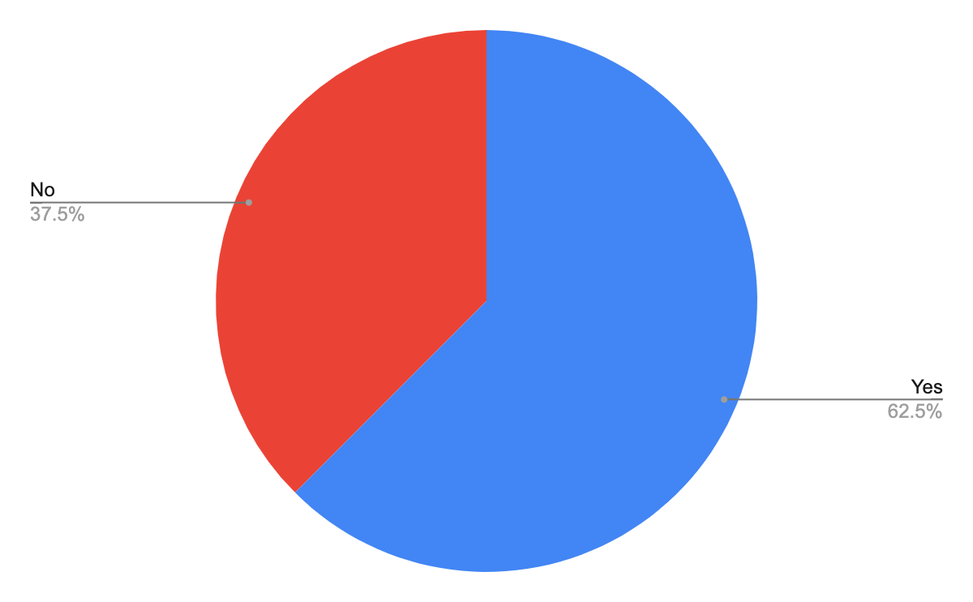
Do you find your physical working environment appropriate and accessible?

Slide 16
Do you find your physical working environment appropriate and accessible?
“I have fibromyalgia, and ADHD but I have been able to manage this myself - particularly since moving to a quiet office that I share with one colleague.”
“I work in a shared office and have a desk allocated to me. However, I could do with some shelves or cupboard space to store papers, files, etc.”
“I have had support from posturite and OH and now have an adjustable desk and chair.”
“No lift access to many labs”
“Only narrow stairs access to office limits access for those with reduced mobility.”
“I am able to work in a quiet, private office, which really helps”
“My disabilities…are not physical…Having said that I broke my leg last year and on returning to the department the regularity of the lifts breaking down did become an issue.”
“I'm on a floor with no toilets... sounds minor but being perimenopausal and with IBS it can sometimes be a little problematic!”
“My office has no central heating in winter and the oil heaters take a long time to warm up and make any noticeable difference to the temperature.”
“Based on the first floor…I don't have access to hot drinks (I have 2 fire doors and one flight of stairs plus 2 sets of split stairs to navigate).”
“I've become so used to coping with an open plan office but would welcome a chance to also have a quiet space available.”
“I like my job and wouldn't leave it but I may not be able to do some aspects of it in the future”

Slide 17
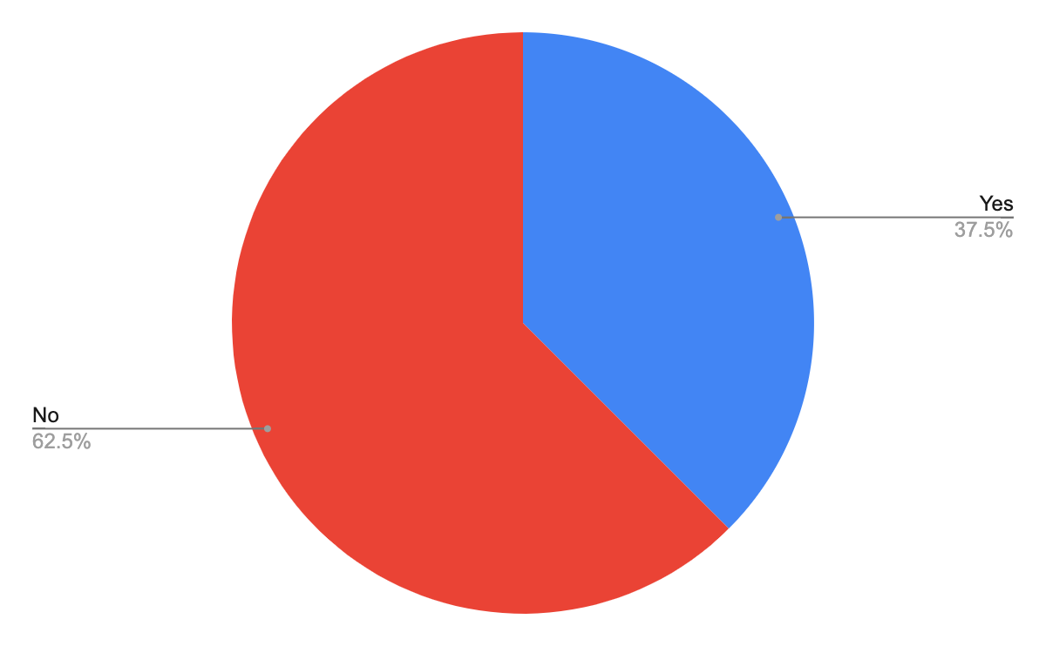
Are there any adjustments to your physical working environment that would enhance your ability to carry out your role and manage your health?

Slide 18
Are there any adjustments to your physical working environment that would enhance your ability to carry out
your role and manage your health?
“More access to kitchens/drinking water - currently i have to access a lot of stairs otherwise (constantly throughout the day)...drinking water on every floor would be better.”
“More reliable lifts”
“Quiet rooms for breaks - being in a shared office all day is extremely exhausting and there is nowhere to have some silence or to lie down/rest with my head supported”
“Working central heating so that the room is comfortable to work in”
“Provide some storage space so that I have more room on my desk”
“Not sure yet - it depends on how my illness progresses”
“A quiet space ”
“I'm asked to attend the office on hot days like this week when temps are 26degrees + and I have MS so I'm more in pain and likely to get dizzy.”

Slide 19
Working Hours and Patterns

Slide 20
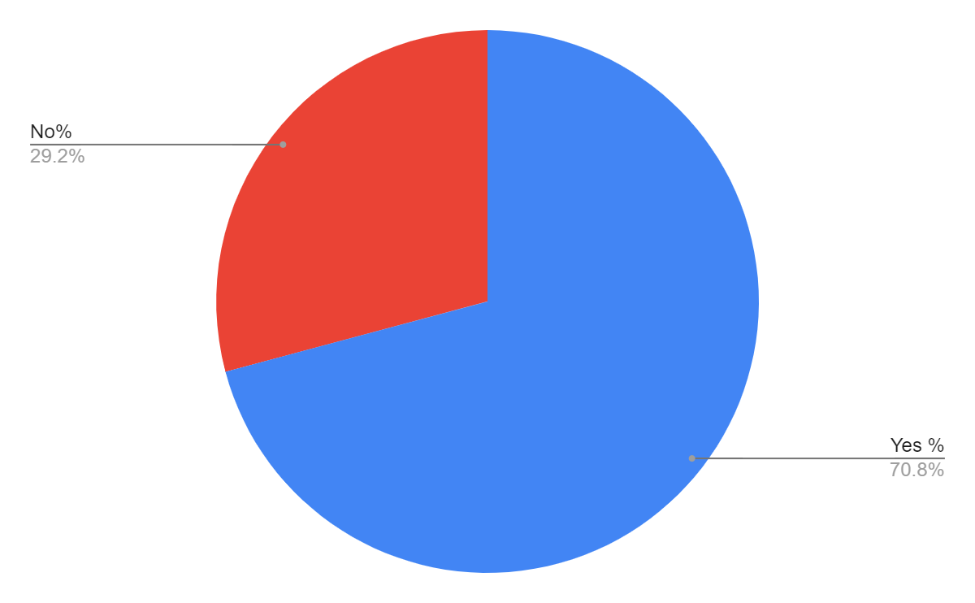
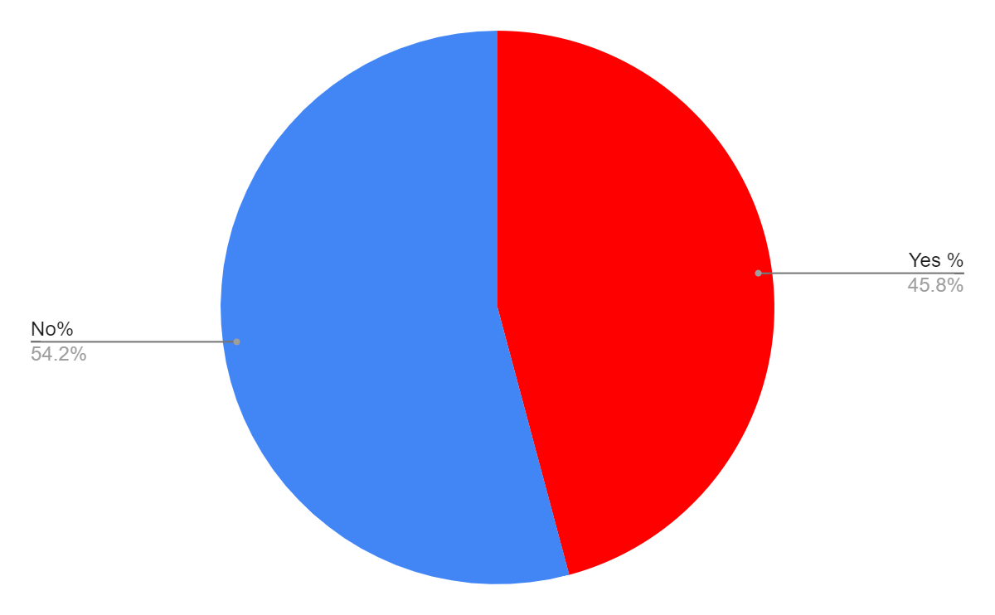
Working Hours and Work Patterns
Are there any adjustments to your working hours or patterns that you feel would enhance your ability to carry out your role and manage your health?
Do you find your work hours and patterns accommodating of your health?
Notes:
Note re colour changes - red is what we are most interested in

Slide 21
Working Hours and Work Patterns
“It can't be helped, but our student contact time can fluctuate throughout the year. For example, May of this year was particularly difficult as it is a busy time anyway, was unusually busy this year, had three bank holidays so 3 out of the 4 weeks I had to fit 5 day's worth of students into 4 days, added to which I was suddenly told with very little notice that I had to change offices and couldn't use my office due to building work. This meant trying to find time between students to pack up all my things, sort out all confidential paperwork, secure documents and resources etc. Due to the fact that I'm still recovering from Post-Covid, I have been literally unable to do anything at home and have had to get additional childcare so I can sleep in the day at weekends as I am so exhausted.”
“There may be some days when I can't get to work because I'm in too much pain to walk”
“At the moment but in future I foresee needing to work more flexibly as my condition deteriorates”
“Fixed working hours means that however you're feeling you have to be there at a certain time and remain there until a certain time.”
“No flexibility”
“I have to drive in due to health and to avoid a longer drive and not getting a space close to my work location, I have to get in by 7.30 am and yet I am not allowed to leave earlier or work longer, yet less days.”
“There is no compulsory day of presence on campus, which means I have been able to change my non-working day to what was most supportive to my health.”

Slide 22
Application and Hiring Process
Notes:
As I mentioned earlier, a number of barriers perceived amongst disabled people in terms of getting considered for jobs - so we wanted to look at experiences of those who had found their way into employment

Slide 23
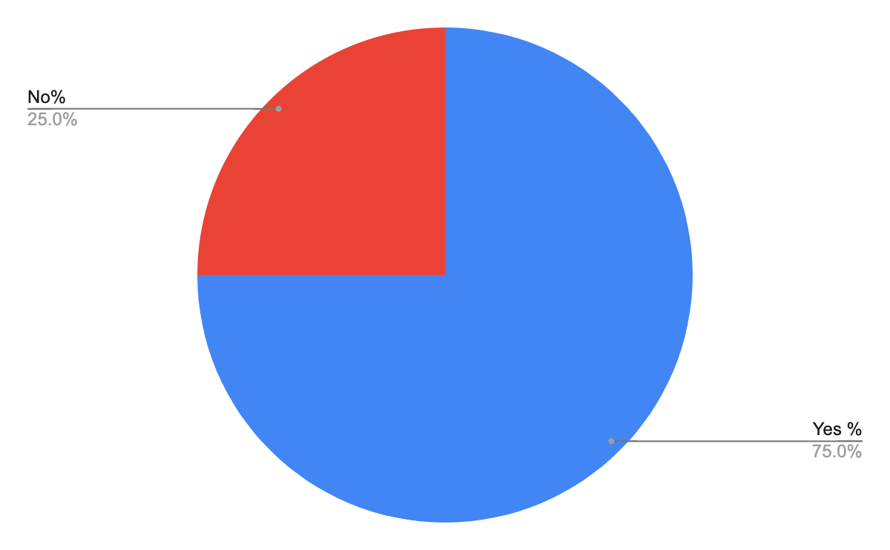
Did you find the application and hiring process for your role appropriately accessible?
Notes:
Something to notice here is that a lot of people here mentioned they were hired before their health problems really began to impact their work - which shows the importance of constantly revising and analysing support processes for staff - and keeping communication channels open for staff

Slide 24
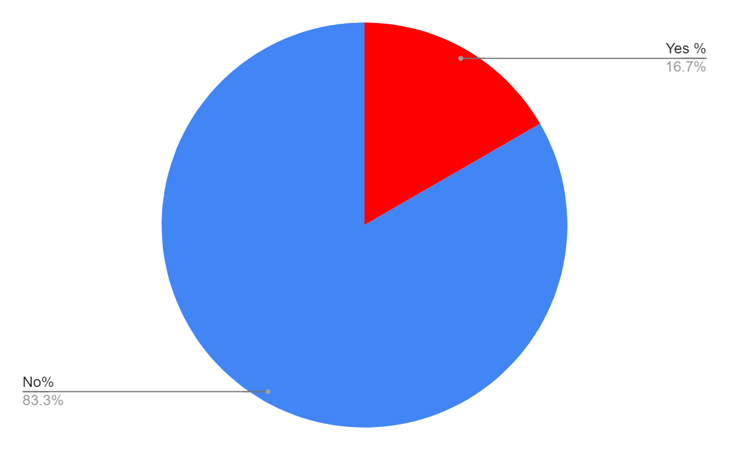
Are there any adjustments to the application and hiring process that you feel would make the process more accessible?
“At the time I thought it was ok but now more is known about neurodiversity I think more things could have been included e.g. photos of the recruiting panel in advance, some questions sent in advance, questions written out and put in front of me when being interviewed”
Notes:
This is very common - just because something is ‘ok’ doesn’t mean it can’t be improved on

Slide 25
Barriers, Hurdles and Discrimination

Slide 26
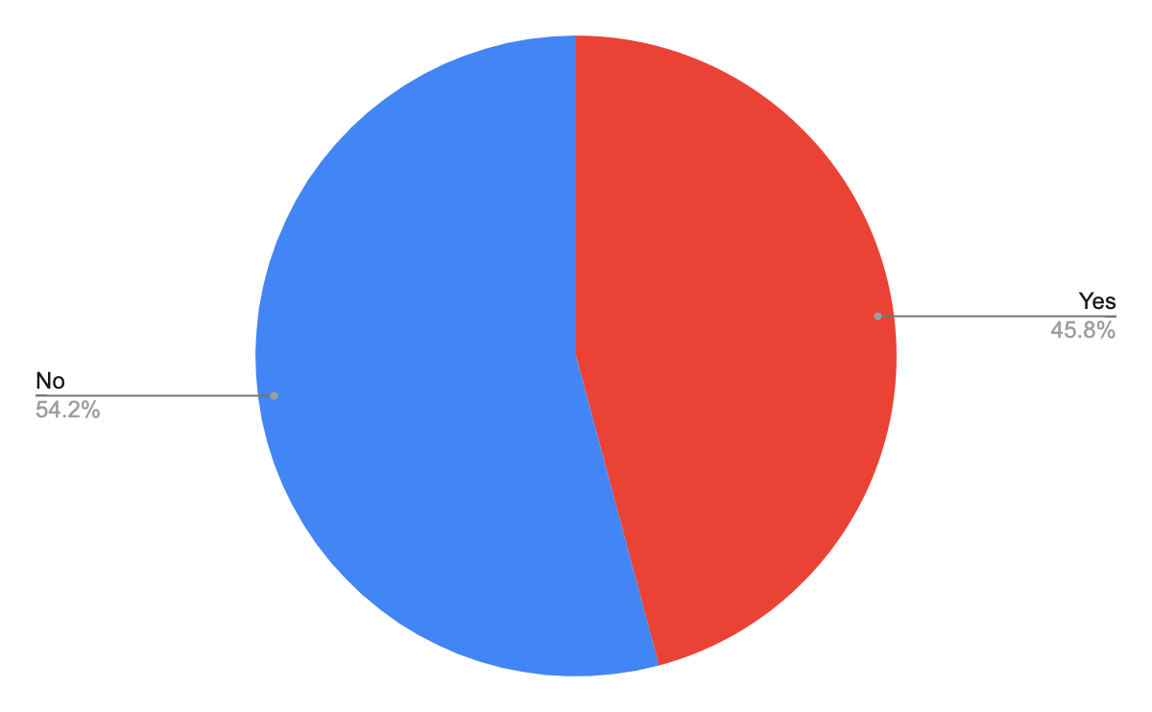
Have you faced any barriers or hurdles in the University as a result of your disability and/or chronic illness?
Notes:
COLOURS SWITCH HERE TO KEEP RED AS CONCERNING AREA

Slide 27
Barriers and Hurdles
“Working in a noisy environment“
“I have had to fight for my adjustments and spend a lot of energy and time outside of work trying to build up evidence to support my case.”
“Have not spoken much to others in and around my lab, struggle to attend social events (formal or informal)”
“Management and HR are completely ignorant on any issues around disabilities that are invisible (ME, chronic Fatigue, FibroMyalgia, post concussion, menopause....)”
“It's hard for people with conditions such as IBS to have fixed working hours and be tied to meetings all day.”
“Considerable difficulty in moving between Firth court and other areas of the University without crossing Broad Lane. It's possible, but a long detour. I appreciate the sloping geography of the site.”
“I had to get support from OH to get the things in place I needed, my previous manager was not accommodating or supportive”
“I might miss meetings if I am ill on a day I was planning to be in the office; I worry as I don't want to let people down or just be out of the loop. Also, I miss out on evening social events as my illness tends to be worse in the evenings.”

Slide 28
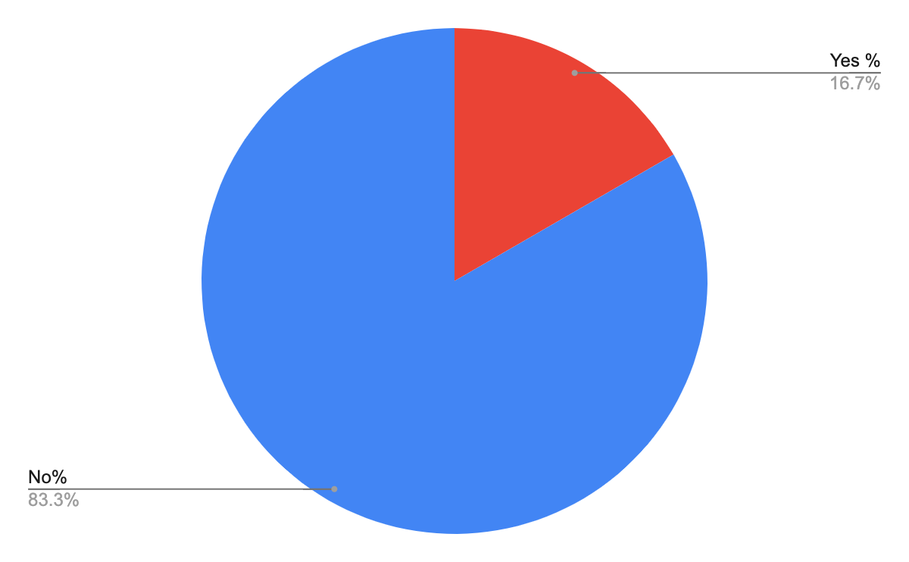
Have you faced any discrimination in the workplace as a result of your disability and/or chronic illness?

Slide 29
Have you faced any discrimination in the workplace as a result of your disability and/or chronic illness?
“I have faced discrimination from some staff due to my disability”
“My team is incredibly supportive.”
“When I have been off due to mental health I have returned to comments from a colleague such as have a nice holiday?"
“I've had my condition mocked, like it's funny. Intrusive questions about my condition. Scepticism about my condition (it's hidden).”

Slide 30
Are there any additional barriers or hurdles outside the workplace, that you face as a result of your disability and/or chronic illness, that impact your ability to carry out your work?

Slide 31
Additional Barriers Outside The Workplace
“Abuse and lack of personal support can mean coming to work emotionally drained”
“Hospital appointments have to be scheduled when most convenient for the nhs/doctors (i have no say in when these are scheduled and rearranging them would mean i would have to miss appointments). this means i may miss opportunities for certain things (workshops/meetings/conferences,etc)”
“I have prosopagnosia and don't remember unfamiliar faces. This is a problem at conferences etc.”
“Single parent of two disabled children, financial difficulties…etc Exhaustion affecting my ability to keep the house in order. Completely overwhelmed with everything. Feel like there's nowhere left to turn. Not able to be a good mum/friend/family member.”
“Being on a fixed-term contract (10 months) that might not be renewed is a problem for me because it increases my level of stress and anxiety. It damages my wellbeing and my productivity because I have to spend time and energy searching and applying for other jobs”
“I have limited energy to spread over a lot of things, if something takes up my energy outside my work life, this can make me slower at work. On occasion I have become too tired or overwhelmed and had to take sick days to recover from a combo of work and other life.”

Slide 32
Key Issues and Findings
Flexibility in start/end times
Quiet spaces for quiet work or breaks
Accessibility of workspaces - reliable lifts
Easy access to toilets, water, drinks etc
Transport issues to and from work e.g parking
Understanding from managers
Making people aware of changes/needs in advance as much as possible
Clarity of signposting to further support
Small adjustments can make a big positive difference
Conditions fluctuate - important that channels are kept open and possibilities for adjustments are always open
Responsibility of organisation, individuals, colleagues and managers
Notes:
Instances here of unsupportive managers, of unhelpful policies, of individuals not asking, and unsupportive colleagues

Slide 33
Access To Work
Access To Work - https://www.gov.uk/access-to-work
Designed to help those with physical/mental health conditions/disability get or stay in work
Can apply for:
A grant to pay for practical support with your work
Support for managing mental health at work
BSL interpreters, lip speakers or note takers
Vehicle adaptations to help with getting to work
Taxi fares to work if public transport is not an option
Support worker/job coach to help in the workplace

Slide 34
Access To Work : Support Plans
Can also help with support plans related to:
flexible working patterns to accommodate changes in situation, health, impact of medication etc
providing a mentor to give you additional support at work
giving you additional time to complete certain tasks
providing you with additional training
regular meetings between you and your manager to talk about your concerns
a phased return to work, such as reduced hours or fewer days

Slide 35
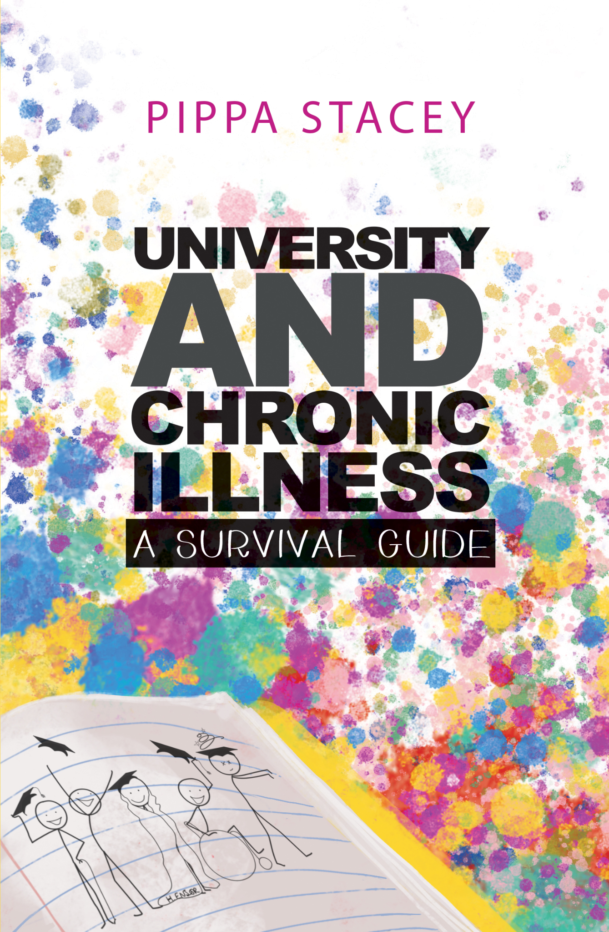
Recommended Reading
A guide to navigating university (as a student) with a chronic illness, including tips on:
Accessing the best support and healthcare
Considerations when choosing accommodation
Identifying manageable and non-manageable house tasks
Engaging with social occasions and forging relationships
Tips and equipment (e.g lightweight kitchen pans, remote control kettle)
Available financial support and finance management
Notes:
Reports from Astriid and Evenbreak that I quoted earlier - UEA put out an Employer Insight Report in January of this year making recommendations on supporting staff with long-term health conditions at University of East Anglia

Slide 36
Actionable Ideas
Allow flexibility (within reason) when it comes to working patterns: Do staff have to be in the office at 9am exactly every day?
Think about travel to/from work (incl. parking) and throughout the work day e.g between buildings
Think about work set-ups and access to key facilities such as toilets, drinks equipment etc
Quiet places with low sound/light and comfortable places to rest
Signpost towards Occupational Health, Access To Work, and other university support networks
Record video meetings so that those absent can catch-up (Most video call software has automatic closed captioning)
Keep staff up to date on any potential upcoming changes/demands including meeting requirements/expectations
Deliver information in a way that is easy to process and re-access - text, screenshots, links, videos etc
Ensure staff are included socially as much as possible
Attend university groups/join networks to keep up to date with changes/learn about other experiences
Make the possibility of support and continuing adjustments clear, rather than relying on the individual - nobody knows everything, things will change
Notes:
Individual circumstances will change, workplaces will change, policies will change, possibilities will change - best placed to better support colleagues but also be an advocate for yourself

Slide 37
Contact
j.carnie@ntdc.ac.uk
Notes:
Would like to do more work in this area - whether that’s expanding this survey nationally - connecting groups looking at these issues for technicians or wider university staff, please do get in touch

